Slide 1
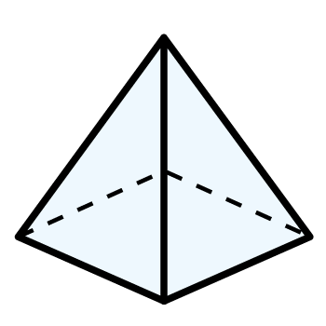
Year 3 | Week 5 | Day 2

Slide 2
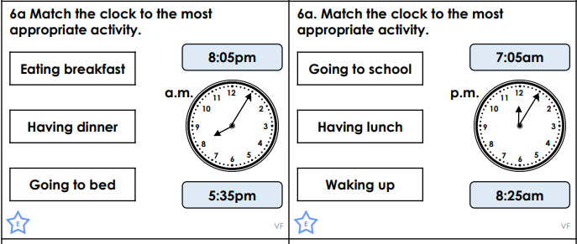
Now try this:

